Slide 1
Nick Morgan - Chapeltown Citizens Advice ( he/ him )
Organisational and personal journey - these are my considered views and perspective: formulated with a huge contribution from all of my colleagues over the years.
Most recently all of the staff at CCA - and in particular Sharon Kelly, Advice Service Manager

Slide 2
Why pay anything but nominal heed to Race disparities research?
Challenge to social injustice - is a core value.The fact that by doing nothing we are perpetrating social injustice is reason enough
This work grows ourselves, our staff and our communities. It increases our relevance and reach
We will gain relevance to neighbourhoods and communities: “the rooted in our communities”
We will reduce systemic racism within our service
Pathfinder national charity

Slide 3
Chapeltown , Leeds
1974 - set up as a CAB
Staff were heavily involved in and Committed to CAB Yorkshire and Humberside Black Workers Group of which they were founder members.
The first black representative to sit on NACAB Council came from Chapeltown CA - a major piece of work carried out by the group was to train all Staff from NACAB Council right down to frontline staff on racism awareness.
This powerful support group formed the catalyst for other support groups within the service to develop nationally.

Slide 4
More recently
BLM - the murder of George Floyd was a moment that resurfaced hundreds of years of history - starting with the dehumanisation of Black people centuries ago.
Within us as a community there were painful memories, revulsion and an awakening that we, as a community were not doing enough both individually and collectively.
Stark gap in reaction between White and Black and Asian staff.

Slide 5
Working on ourselves
Pre requirements
The establishment of a safe environment
This training should include practical exercises that provoke authentic discussion and provide tools and methodologies for dealing with concerns as they arise
Initially we want there to be separate group based on self determination of ethnicity - white and people of colour

Slide 6
Learning outcomes
Delegates should develop an understanding of their own part in a system that is systemically racist.
Delegates should develop an understanding of the privilege that whiteness brings.
Delegates should develop an understanding of stereotypes and how they they sit deep within our psyche.
Delegates should develop their confidence to challenge racism both internally and externally, to raise issues and to (self) reflect on issues raised.
Delegates should learn how to challenge and address both conscious and unconscious bias and about embedding change and organisational processes to deal with this.
CCA should develop an agreed terminology on alternatives to BAME and an understanding of terminology used in present day conversations.

Slide 7
looking at our own selves
To that end we split into groups:
staff who identified as people of colour and staff who identified as white.
This allowed White staff to discuss racism without relying on Staff of colour to lead by sharing their own experiences
It gave staff of colour space to discuss their experiences at CCA

Slide 8
The results
Biggest learning was the potential ability we now have to talk about racism with and discuss our own actions: ( it has not eliminated them). White fragility has diminished, there’s as better understanding of white privilege.
White advisers and staff in particular are more comfortable asking questions about discrimination and racist experience from clients and service providers
There is a validation of experience and a comprehension of how different staff and clients are received according to their appearance. There is an acknowledgement form white staff that we can turn off and take a break because we are not visibly different
As a staff team we also know from our experience that the darker your skin the more likely you are to receive poorer service across the board.
We also know that our volunteers and staff with a “foreign accent” are more likely to receive implicit racist attitudes in their daily working life (eg from DWP, clients)
We are more comfortable and better at looking through different lenses - not so mono ethnic for instance
Added a dimension / perspective to our work eg R and C

Slide 9
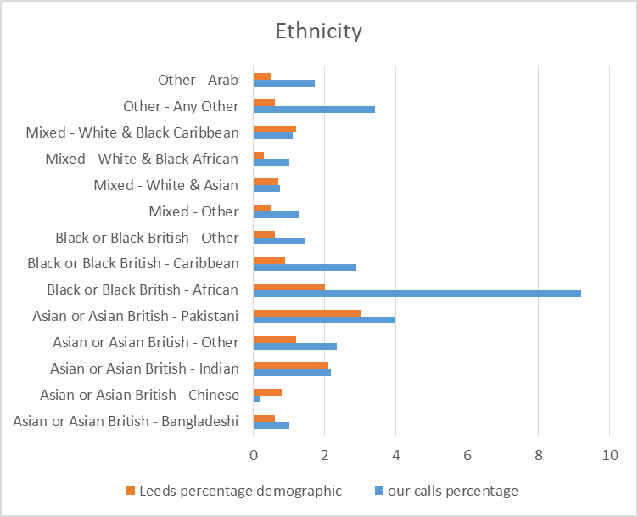
Communities analysis CCA

Slide 10
Ask of Clare Moriarty on her visit
We would like to address how the national service decisions can impact on our reputation locally and how we would like that to be given more thought.
For instance the lack of face to face for help to claim was a stark example and the DWP’s glib response of sending those people that need face to face to the JCP: unacceptable.
With the Windrush scheme previously run by the service we fielded angry questions from community representatives from across the region and held a meeting here to explain the poor process and take up by local CA to participate in the scheme.
Asked for Cit A to be braver when it comes to calling out systemic racism within policy and the impact this has on communities. We asked that service wide we are braver in using our data in identifying and calling out systemic discrimination and advocating strategies to address this.

Slide 11
What solutions might look like
We know that this is a serious effort by our national team to move forward and make a difference by using research to provide more expansive , qualitative substance to the already held data and help the whole service come up with solutions.
A way of looking through the lens of different communities both operationally:
we know we can get it wrong and we look for trends and as managers will take the temperature of clients and staff: We’ll wonder what the contributory factors are to interactions in a very open way that includes race as a factor.
Data dive about levels of service - which communities are provided with casework and does that match proportionally
And strategically:
Networking and working with local community groups; may be repairing bridges, connecting and creating an understanding and shared value warmth.

Slide 12
What will this require of us
An openness in mind and heart to the findings of the research - and the desire to create positive solutions followed by the drive to lead and implement them.
This is a comprehensive piece of work and the leadership team have taken a risk in devolving power to Hello Brave and the research group.
Emotional investment - I believe this is emotional work based on my own experience and such work requires time.

