Slide 1

Race disparities research
Peer group conference
Mandeep Rupra [she/her]
Director of Equity and Belonging

Slide 2
About the session
The aim of this session is to:
Provide an overview of insights and recommendations from the race disparities research
Discuss practice from across the network

Slide 3
Mission 2: Close the gap
End the disparities in access and experience for marginalised people
Structural inequalities in society not only drive demand for our services but also lead to certain people facing disadvantages, making them more likely to need our help. This is why we address inequality by both advocating for change and prioritising the needs of marginalised people who might not otherwise get the support they need. Our equity based approach shapes how we design our services and create an inclusive workforce.
What we’re prioritising in 25/26 (at national):
Mobilise colleagues to embed race insights into practice
Mobilise colleagues to embed disability insights into practice
Develop an approach to lived experience
Workforce disparities - there are two sides of the ‘coin’ for mission 2

Slide 4










Advancing Race Equity since 2020
Race Equity Data Deep Dive:
CX, NOIR data and analysing quant and qual data, intersectionality
Priority are of focus: Race Equity became a business priority - Inclusive Access
Race Equity Advisory group launched - servicewide focus on progress
Anti-racist principles launched, in RM Toolkit 2
Mission 2
Race Equity Specialist, RDR research
Developing a race equity narrative: explicitly talking about race and racism
Racial disparities in self service research:
Small scale qual research showing the barriers to access advice for clients of colour
Capability building:
3 Race Matters Toolkits, webinars, panels
Race Matters Workforce Theory of Change: KPIS
Collective responsibility
Working together to understand our clients and support those that are most marginalised

Slide 5
A note on the external context…..

Slide 6
Poverty
Despite only making up around 15% of the population in the UK, 26% of those in ‘deep poverty’ are from a minority ethnic background. Bangladeshi and Pakistani families experience the highest rates of poverty among people of colour. Rates of poverty for Black, African, Caribbean and Black British groups have also been consistently higher than that for White people. Bangladeshi households are more likely to be inadequately heated. Black, Bangladeshi and Pakistani households are also more likely to be in arrears and unable to afford essentials.
Employment
Unemployment for White people is about 3% and 7.5% for people of colour. This rises to 9% for Bangladeshi and Pakistani people.
Racialised minorities are overrepresented in low-paid and gig economy employment. Women of colour are almost twice as likely to be on a zero-hours contract as White men and almost one and a half times more likely than White women.
Housing
Black-led households are 50% more likely to face the risk of homelessness than White-led households. Research emphasised the connection between direct racial discrimination from landlords and the risk of homelessness facing Black people.

Slide 7
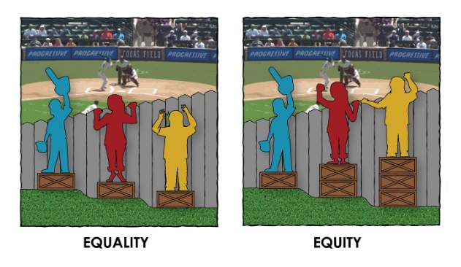
A social justice approach to EDI
A socially just world meets everyone’s basic needs: food, housing, health care, education, work, and social security. It treats people from every background with dignity and respect, guarantees equitable distribution of resources, and ensures everyone has a voice in the decisions that affect them.

Slide 8
Race disparities have been present in our client experience for at least a decade: race disparities research project

Slide 9
Content warning
The following slides includes sensitive content about the experiences of services for people of colour
Some of the insights may feel hard to hear, as we are describing ways in which we're letting our clients down

Slide 10
About the project
What we asked:
What are the experiences of the communities of colour not currently being well served across the network, and how might we change this?*
*Using participatory, trauma informed methods, to build organisational experience in working in these ways.
What we did:
Taking an asset-based approach, the Hello Brave team
recruited and built relationships with representatives from community organisations who currently centre Black, Chinese and Southern Asian communities (aka clients of colour at Citizens Advice).
We then formed a “Research Group” made up of local and national Citizens Advice colleagues in collaboration with this invaluable group of experts. The group worked together over three months to design and deliver this project.
Overall Process
Project Kick Off & Set Up
Team/Client Convos, Data Deep Dive & =Scoping
Recruitment & Research Group Onboarding
Research Group Sessions & Research
Final Delivery & Debrief

Slide 11
Other details on the brief…
Through team conversations, data analysis and scoping sessions the following brief emerged for this work.
Clients centered in this work:
Bangladeshi
Black African
Black Caribbean
Chinese
Indian
Pakistani
With minimum requirements for: how many people have English as an additional language, are under 25 and / or who live in London
Channels: Face to Face, Phone, Website
Level of Support: Self-Service, Intensive support
Funding type: All delivery & funding types
Advice Type: Benefits & tax credits, Universal credit, Debt utilities & comms, Housing

Slide 12
What we found - the key insights

Slide 13
Race disparities research - key insights
Impact of systemic racism: Due to structural inequalities, racially minoritised clients are often reaching out to us at incredibly urgent moments. Urgency is compounded by clients reaching us “later” due to lower awareness of and trust in Citizens Advice.
Greater urgency: Reaching us when things are more acute also meant long wait times and inflexibility were even more frustrating. Long waits and inflexibility are also hardest for those in financial hardship, as even free advice comes with a cost.
Complexity of issues: Clients with intricate or layered needs were less likely to receive the type of support they wanted/needed.

Slide 14
“I was asked before about my name and the fact that it doesn’t sound Black and then asked where I was from” - Client
“When I got there it was closed. I was crying like hell that I’d used the money from the school to get there and it was closed.” - Client

Slide 15
Race disparities research - key insights
Holistic advice: Clients want advice to be personalised, relevant, and holistic. Reflecting the full complexity of the situation.
Cultural curiosity: Clients valued cultural connection and competency but advisors felt under supported to offer this.
Client journey: Clients also want a closed loop service. With routes forward, follow up and no dead ends.
Community partnerships: Both advisors and clients wanted more community closeness and involvement but that felt limited and hard to do

Slide 16
“The issue was the disconnect between the advice and the reality” - Client
“Better understanding of culture and what people go through based on who and where they are from” - Client
“Citizens Advice could try and understand the person’s whole experience and what other support they might need” - Client

Slide 17
Summary of Recommendations.
Based on their findings and expertise, the research group offers the following recommendations.
Provide staff learning & support to work with centred groups
Increase awareness amongst Black, Chinese and South Asian clients
Offer higher service level to clients experiencing trauma or layered needs
Increase involvement and partnership with centred communities
Recruit and retain a more diverse workforce
Learning around systemic racism and wider systems of oppression
Learning on culture, unconscious bias and diversity
Deeper learning and insights on communities most represented in each areas / for each office
Access to up to date information and services for stronger referrals
Learning on empathy and deescalation
Create a healthier feedback & quality assessment culture
Use branding, marketing and partnerships to reach people from these communities sooner.
Offer enhanced follow up/tracking for clients with a higher exposure to/risk of vulnerability
Make it easier for clients to flexibly attend advice sessions with family etc for translation
Strengthen local office partnerships with community organisations
Train staff at community organisations to offer advice
Note: these are summaries of the 12 hypotheses

Slide 18
Thank you

