Slide 1



Governance – a let’s think dangerously session
Samantha Pritchard, Partner, Head of Charities
11 June 2025
Notes:
Standards of governance have been in the spotlight recently raising suggestions that the current model is no longer fit for purpose. This session will open the debate around whether the current governance structure for charities is broken. And if so, how can it be fixed?
Pat Coomber-Wood (CEO of CA West Northampton and Cherwell)
Tracy Hopkins (CEO CA Blackpool)
Andy Brown (conference organizer, CA Manchester)

Slide 2

What is the typical charity governance model?
CEO
Board of trustees
Members
Members gatekeepers to constitutional change
Trustees hold the legal duties but not involved in the operation of the charity
CEO runs the charity but not a trustee
Notes:
SAM

Slide 3
Has the typical charity governance model broken?
“Board lacked the experience of youth services to interrogate the decisions of the CEO”
“trustees did not fully comply with their responsibilities as trustees under charity law”
“a number of weaknesses and matters of concern in the administration, governance and management”
“A lack of understanding prevented necessary oversight”

Slide 4
Other governance models: Unitary Board
Executive directors run organisation day to day (CEO and senior team)
Non-executive directors provide challenge and support and aid decision making
E.g. corporates
Conflicts of Interest?
Members
Exec and Non Exec Board

Slide 5
Unitary Board ‘lite’
CEO is also a trustee (with Charity Commission consent)
E.g. educational establishments, increasingly in other charities
FD?
Members
Board of Trustees (inc CEO)

Slide 6
Pay trustees?
CEO
Board of trustees
Members
Keep the model
Pay trustees
Charity Commission consent
Paying half of the board
Paying more than half
Notes:
SAM

Slide 7
More complex governance models
Council
Board
Members
CEO
Members include users, staff, volunteers, general public
Council represents members
Council appoints some trustees
E.g. National Trust

Slide 8
Quick wins
Open trustee recruitment
Induction
Training
Skills / EDI audit
Remove a bad apple
Effective chairing
Effective minute taking
Code of Conduct
Not taking things personally
Reflection
Maximum terms

Slide 9
Will it fix things?
No one-size-fits-all solution
Good Governance creates a strong foundation, but quality of board, and ability to work together to achieve a charity’s purpose is key
Change moves at the speed of trust

Slide 10

Q&A
Questions?
Notes:
SAM / ALISON

Slide 11

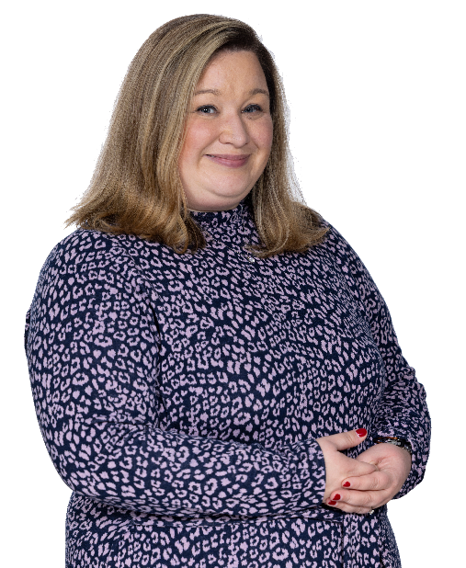
Get in touch!
Samantha Pritchard
Partner
Telephone: 0191 211 7905
Mobile: 07355 092 808
samantha.pritchard@muckle-llp.com

Slide 12


